Slide 1
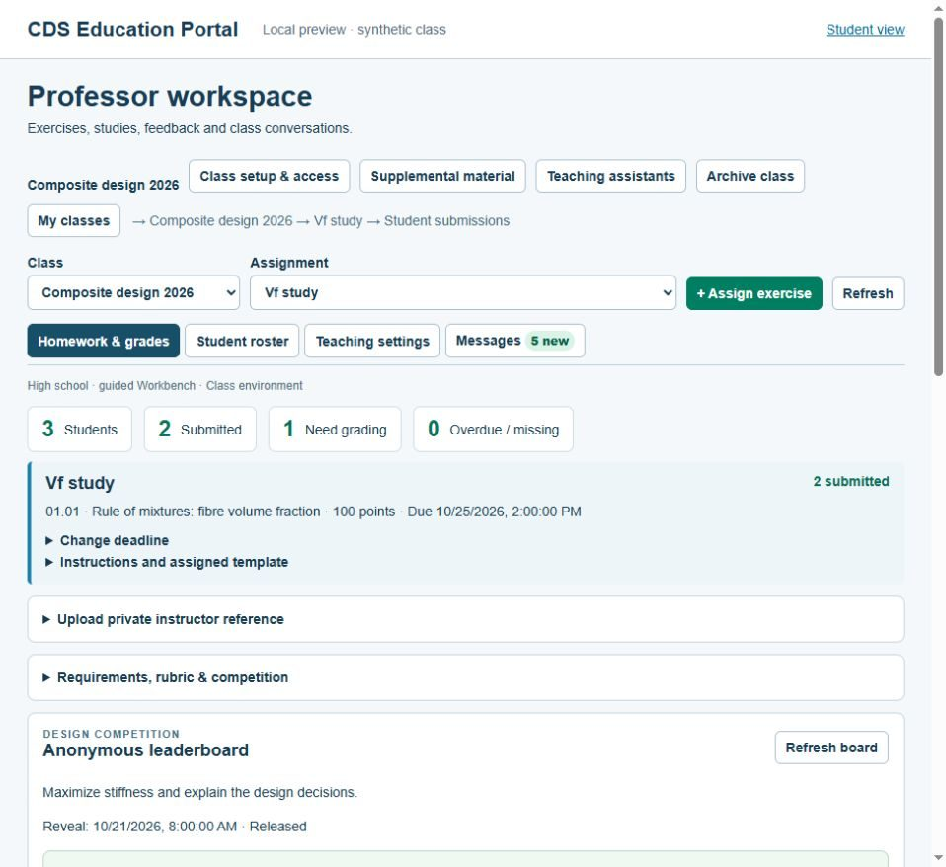
CDS EDUCATION PORTAL
Teach composites through connected studies
A classroom around the engineering work.
Assign exercises, compare saved results, return reviewed changes and grade the reasoning.
From first stiffness studies to advanced process analysis, within the licensed model scope.
Portal preview · synthetic class
CDS Composites | Educator overview | October 2026
1
Notes:
Source: CDS Education Portal implementation prepared 22 October 2026; https://cdscomposites.com/education and https://cdscomposites.com/account/classroom. Interface images are actual light-mode local previews with synthetic accounts and instructional data. No student records are shown.

Slide 2
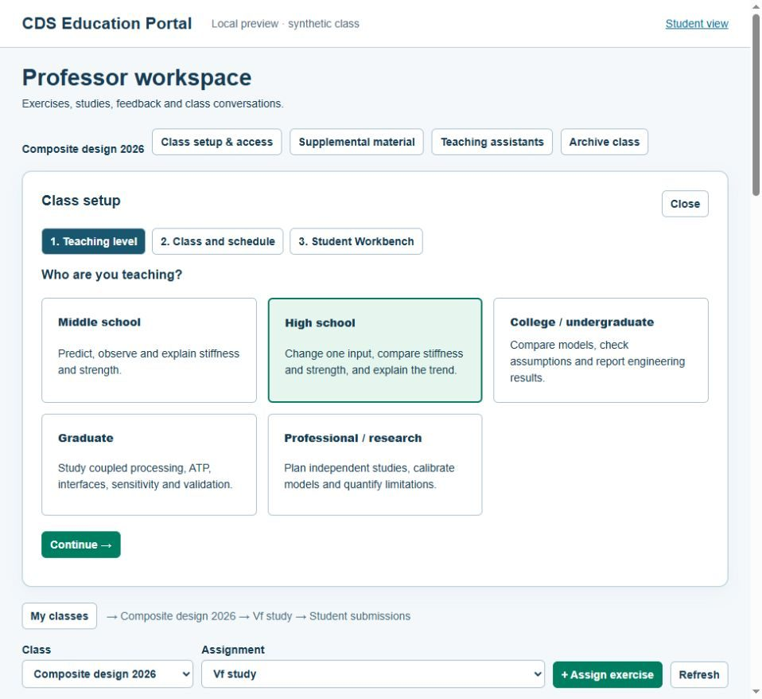
CDS EDUCATION PORTAL
The professor sets the learning environment
Choose the level
Middle school → high school → college → graduate → research
Set Guided, Standard or Advanced Workbench. Restrict class modules to suit the assignment.
Class policy narrows the available license; it does not create new solver access.
Teaching-level setup · actual interface, synthetic class
CDS Composites | Educator overview | October 2026
2
Notes:
Source: CDS Education Portal implementation prepared 22 October 2026; https://cdscomposites.com/education and https://cdscomposites.com/account/classroom. Interface images are actual light-mode local previews with synthetic accounts and instructional data. No student records are shown.

Slide 3
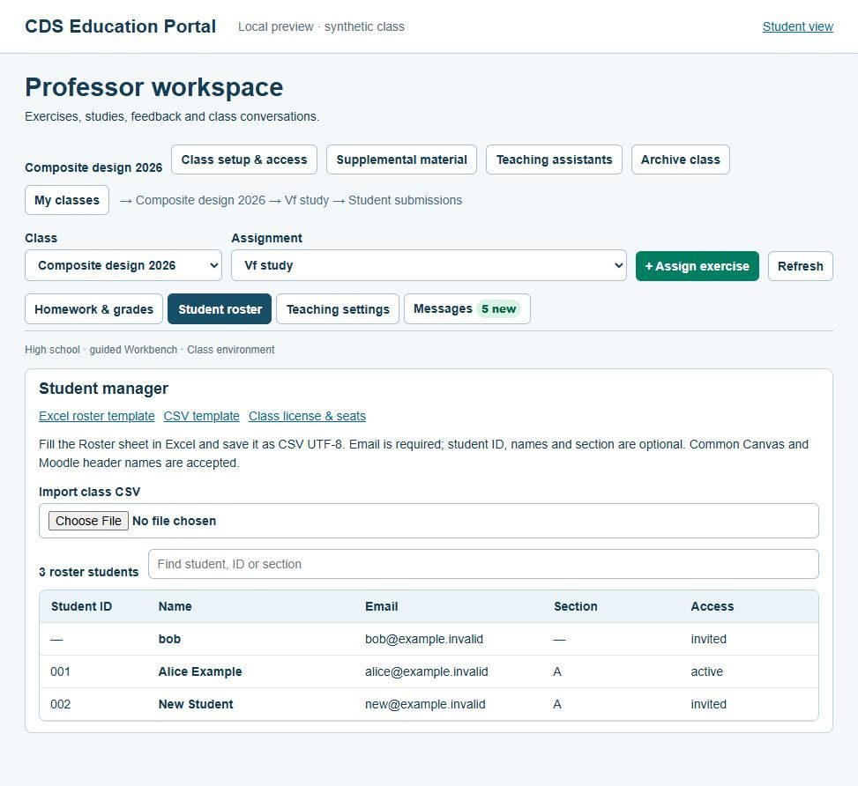
CDS EDUCATION PORTAL
Start with a roster, keep class access clear
Bring the class list
Fill the Excel template. Save CSV UTF-8. Preview the rows before import.
Verified student email + an active class seat provide the licensed access.
Instructor-rostered students do not submit individual student-ID documents. Import does not automatically email the class.
Excel and CSV templates · synthetic roster
CDS Composites | Educator overview | October 2026
3
Notes:
Source: CDS Education Portal implementation prepared 22 October 2026; https://cdscomposites.com/education and https://cdscomposites.com/account/classroom. Interface images are actual light-mode local previews with synthetic accounts and instructional data. No student records are shown.

Slide 4
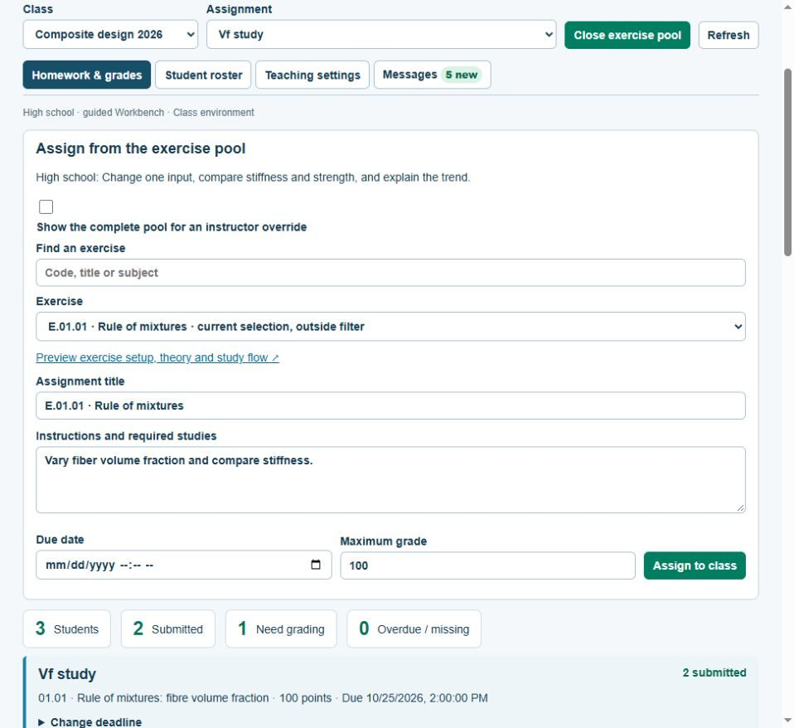
CDS EDUCATION PORTAL
Assign a question students can investigate
E.01.01 · Fiber volume fraction
Compare Vf = 0.30, 0.50 and 0.70.
Save three runs. Explain the stiffness trend and the model assumptions.
Set the deadline, requirements and rubric. Keep a private reference solution.
Exercise assignment · actual interface, synthetic class
CDS Composites | Educator overview | October 2026
4
Notes:
Source: CDS Education Portal implementation prepared 22 October 2026; https://cdscomposites.com/education and https://cdscomposites.com/account/classroom. Interface images are actual light-mode local previews with synthetic accounts and instructional data. No student records are shown.

Slide 5
CDS EDUCATION PORTAL
Compare evidence before assigning marks
01
02
03
Submitted study
→
Class comparison
→
Instructor review
Inputs, named runs and an explanation.
Compatible curves, chosen values and missing evidence.
Rubric marks, targeted comments and a released grade.
Saved results open without a rerun. Independent checks use a separate licensed Workbench calculation.
CDS Composites | Educator overview | October 2026
5
Notes:
Source: CDS Education Portal implementation prepared 22 October 2026; https://cdscomposites.com/education and https://cdscomposites.com/account/classroom. Interface images are actual light-mode local previews with synthetic accounts and instructional data. No student records are shown.

Slide 6
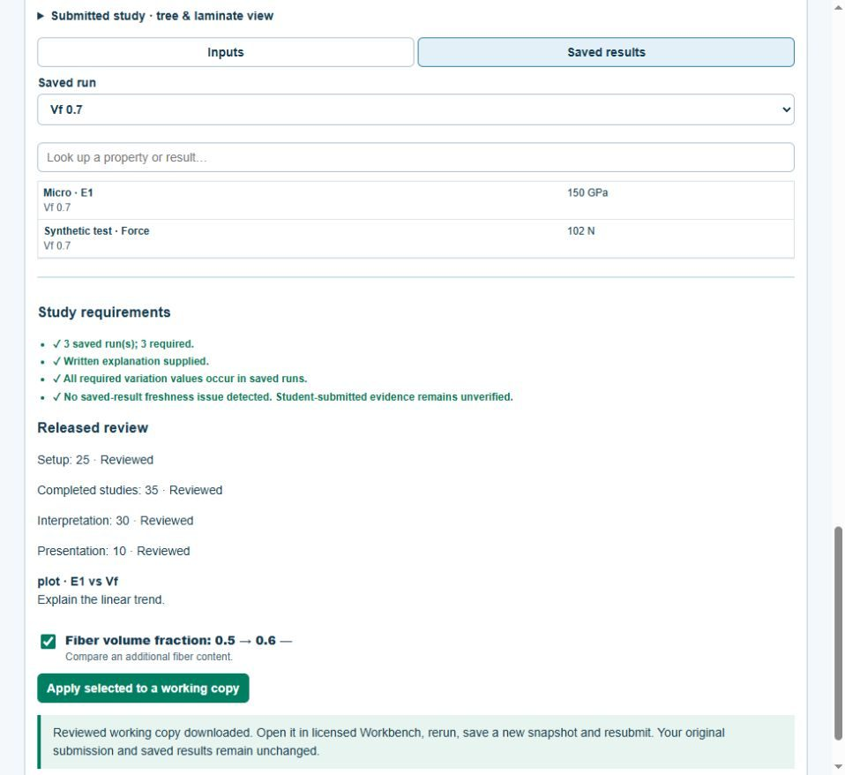
CDS EDUCATION PORTAL
Return a reviewed revision, preserve the original
Explain the change
The professor proposes a numeric input and gives a reason.
The student applies selected suggestions to a new working copy, reruns and resubmits.
Original submissions, feedback and later attempts remain available.
Released feedback and working-copy download · synthetic study
CDS Composites | Educator overview | October 2026
6
Notes:
Source: CDS Education Portal implementation prepared 22 October 2026; https://cdscomposites.com/education and https://cdscomposites.com/account/classroom. Interface images are actual light-mode local previews with synthetic accounts and instructional data. No student records are shown.

Slide 7
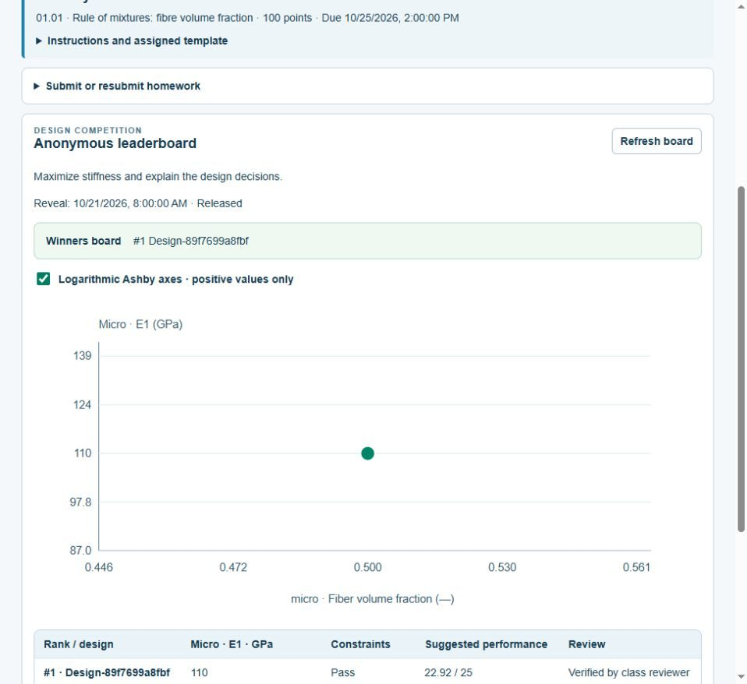
CDS EDUCATION PORTAL
Make design competitions part of assessment
Set a target and constraints
Compare available metrics on an Ashby plot: stiffness versus mass, for example.
Verify entries. Schedule reveal day. Connect performance points to the rubric.
Aliases protect identity from classmates. Suggested scores do not automatically release grades.
Class-only anonymous board · synthetic entry
CDS Composites | Educator overview | October 2026
7
Notes:
Source: CDS Education Portal implementation prepared 22 October 2026; https://cdscomposites.com/education and https://cdscomposites.com/account/classroom. Interface images are actual light-mode local previews with synthetic accounts and instructional data. No student records are shown.

Slide 8
CDS EDUCATION PORTAL
Run the term, then keep its teaching record
During the class
Portal messages, deadlines and supplemental links.
Share the review work
Class-limited teaching assistants and separate grading permissions.
Finish the assessment
Release grades and export CSV for an LMS import.
Return next year
Archive the class; find past cohorts by year and term.
Portal posting does not send email or push notifications. Grade exports are file-based, not automatic LMS passback.
CDS Composites | Educator overview | October 2026
8
Notes:
Source: CDS Education Portal implementation prepared 22 October 2026; https://cdscomposites.com/education and https://cdscomposites.com/account/classroom. Interface images are actual light-mode local previews with synthetic accounts and instructional data. No student records are shown.

Slide 9
CDS EDUCATION PORTAL
Build the first class together
1
Register as an Educator and verify the email.
2
Open the training manual in My Account.
3
Confirm the class license, then pilot one assignment.
cdscomposites.com/education
The public overview introduces the portal. The signed-in educator manual provides the working procedures.
CDS Composites | Educator overview | October 2026
9
Notes:
Source: CDS Education Portal implementation prepared 22 October 2026; https://cdscomposites.com/education and https://cdscomposites.com/account/classroom. Interface images are actual light-mode local previews with synthetic accounts and instructional data. No student records are shown.

